Slide 1
Reported Speech

Slide 2
Reported speech is when you tell somebody else what you or a person said before.
Reported Speech is used ‘say’ , ’ tell’, dan ‘ask’ as reporting verbs.
example:
She said that he went to Stanbrain,
He told me to close the door.
She Asked me where I would go.

Slide 3
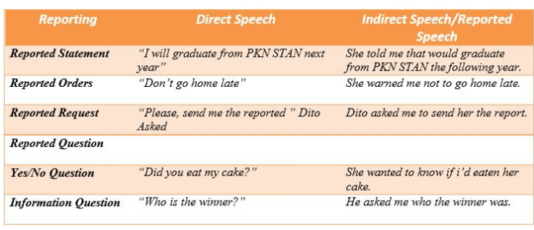
reported speech types.

Slide 4
Reported Statement
It is used “tell/told” or “say/said”. We also use,such as, suggest, advise, etc. In the reported speech, we use “that” as conjunction.
example :
Direct Speech : “The weather is really nice today,”Dito says
Reported Speech : “Dito said that the weather really nice that day”

Slide 5
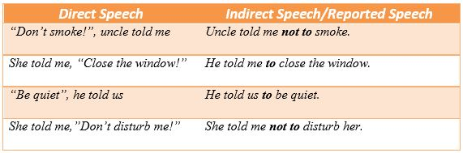
Reported Orders
It is used to give a command and also invitation. In the reported speech, we use “tell+to/not to” to connect the sentence.
example :
Direct Speech : “Don’t go home late!”
Reported Speech : “He wanted me not to go home late”

Slide 6
Reported Questions
transform the question into an indirect question
use the question word (where, when, what, how) or if / whether
Example:
Direct Speech : She asked me, “Where do you live?”
Reported Speech : She asked me where, I lived.

Slide 7
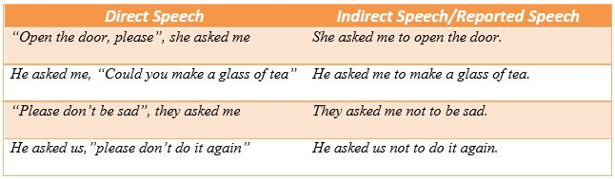
Reported Request
Reported request is transforming requests and commands. It is used ask + to/not to infinitive.
example :
“Please send me the reported,” Dito Asked.”
“Dito asked me to send her the report.”

